Slide 1
Automation
A Simple Idea, with Complex Concepts
Jim Price, Sr. Manager Professional Services
James Nickerson, Lead Developer Professional Services

Slide 2
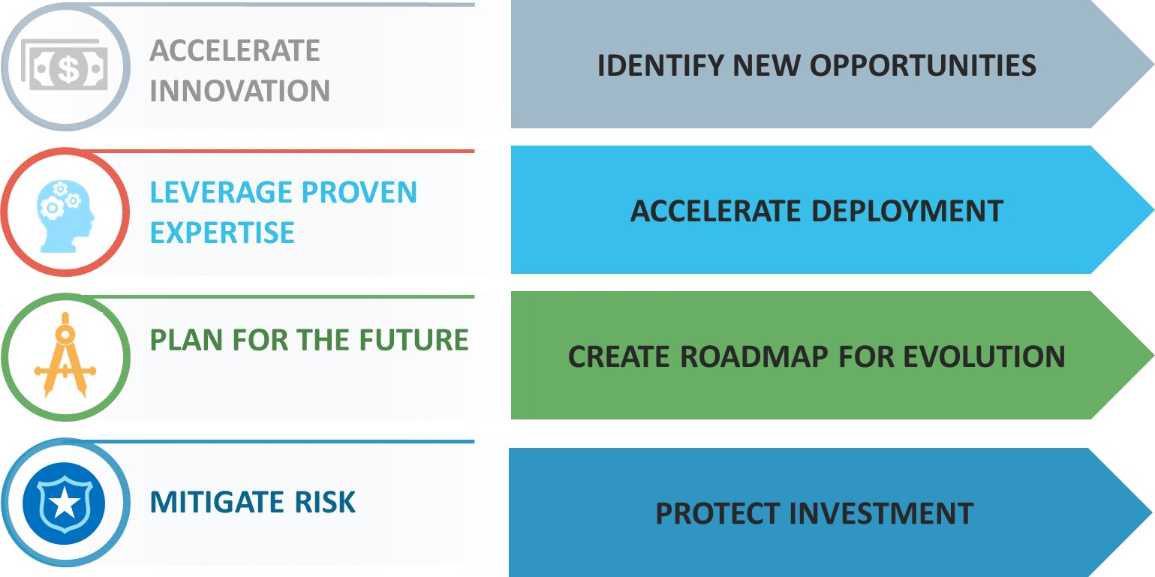
Consider Today Within The Context Of…

Slide 3
Services Across Your Network Lifecycle
Enabling you to drive more value from the network
Plan
Build
Operate
Lifecycle Phase
We can help you to….
Design your ideal network
Deploy fast, secure, and effective networks in less time
Protect your business and get more done

Slide 4

AGENDA
Automation
What is it?
Why is it important?
Solutions
Types of automation
Building blocks: Juniper & Open Source
Examples
Zero Touch Provisioning (ZTP)

Slide 5
AGENDA (Continued)
Tools
Puppet
Chef
Ansible
Netconf
SLAX & Juise
Code Libraries
Case Studies
Resources
Hands-on Exercises

Slide 6
Defining Automation
Webster defines Automation as:
The operation of an apparatus, process, or system by mechanical or electronic devices that take the place of human labor.
We define Automation as:
The use of Standard’s based tools (APIs, Scripting, Provisioning Tools, etc.) to perform tasks to meet customer requirements with little to no human interaction required.
Notes:
A simple and Unified definition of automation
We have to start somewhere….

Slide 7
Types of Automation:
What are you going to automate?
Deployment Automation
Migration Automation
Operations Automation
Configuration Generation Automation
Network Compliance Auditing Automation
Service Provisioning Automation
Etc…

Slide 8
Why Automate

Slide 9
Automation: Why
Business value
Business Continuity
Reduce Cost
Accelerate Business
Simplified operations
Increased operations control
Standardization
Pro-active remediation
Reduced remediation time
Hardened certification
OPEX savings:
Improved efficiency
Effective resource utilization
Reduced fees
Network Build
Certification time
Service creation
Service elasticity
ROI

Slide 10
Automation Opportunities continue throughout the Network Lifecycle
PLAN: Design & Certify
BUILD: Implement & Migrate
OPERATE: Audit & Testing
Design Validation
Product / code
Feature
Workflow
Zero Touch Provisioning
Configuration Generation
Network Stand-up
Rapid Deployment Migration
Validation
Configuration Compliance
Run State Compliance
Product Compliance
OPERATE: Product Lifecycle
OPERATE: Service Provisioning
OPERATE: Troubleshoot
Software Upgrades
Updates Based on Events
Inventory
Alerts & Remediation
Service Creation
Scale Up/Down
On/Off Box Coordination
Change Impact
Fault Finding
Remediation
Escalation

Slide 11
How to Build Automation Solutions

Slide 12

Automation is Like Ice Cream
Everyone want it
Everyone wants something different
No-one wants to make it
No-one wants to clean up the mess

Slide 13
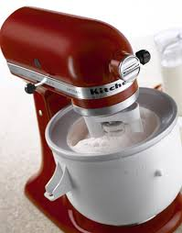

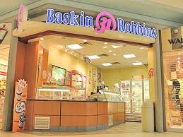
Automation: How do you want it to be?
The ice-cream analogy
BUILDING BLOCKS
SCRIPT
IT
The Grocery Store
Automation capabilities
DIY with
Kitchen-Aid
PRODUCT
Banana Split at Baskin Robins
Programing Expertise

Slide 14






Automation: How
Juniper building blocks
On-box
ZTP
JEAP
Network Director
Security Director
Service Now
Service Insight
Configlet
Contrail
Ruby-EZ
PY-EZ
Snapshot

Slide 15










Automation: How
Open source building blocks

Slide 16
Programmable Interfaces for Junos
INNOVATION LEADERSHIP build on One Junos
Junos XML API – workflow automation
Junos Script
XSLT
SLAX
Netconf
Http
Junos SDK API – new features and functionality
Control Plane API
Data Plane API
Remote API
Junos Space API – intelligent and programmable NMS
Contrail API – SDN and NFV orchestration

Slide 17
Deployment Automation

Slide 18
Large Restaurant Chain
Traditional deployment of Juniper devices across 1000+ concept restaurants is time-consuming and error-prone
Customers Problem
Provide a one-touch provisioning solution – a custom web-based solution that is simple, reliable, flexible and scalable to rapidly configure and deploy Juniper devices
Solution

Slide 19
Project Challenges
Aggressive schedule
Integration into existing MS SQL database
Incorrect data in the database and poorly built templates
Device bootstrap process
Customers Challenges
Learning curve – first of its kind
Limited Initial information from customer
Large number of moving parts
Internal Challenges

Slide 20
Solution at a Glance
Simple
Custom Web-based Interface and management
Configurations based on minimal input about each site
Interface does not require high technical knowledge
Reliable
Leverages pre-defined configuration templates
Standardized configuration applied based on selected criteria
Minimizes/eliminates configuration errors
Flexible/rapid deployment
Multiple staging environments
Accelerated and hassle-free provisioning of multiple devices for multiple stores in parallel

Slide 21

Deploy New Equipment
Sounds simple enough?
Install Device/Role Specific Junos OS Software Image
Install Device/Role Specific Configuration File

Slide 22
But There’s Always More Workflow…
Bootstrap DHCP / TFTP
Install Device/Role Specific Junos OS Software Image
Install Device/Role Specific Configuration File
Register Device
with Inventory System

Slide 23



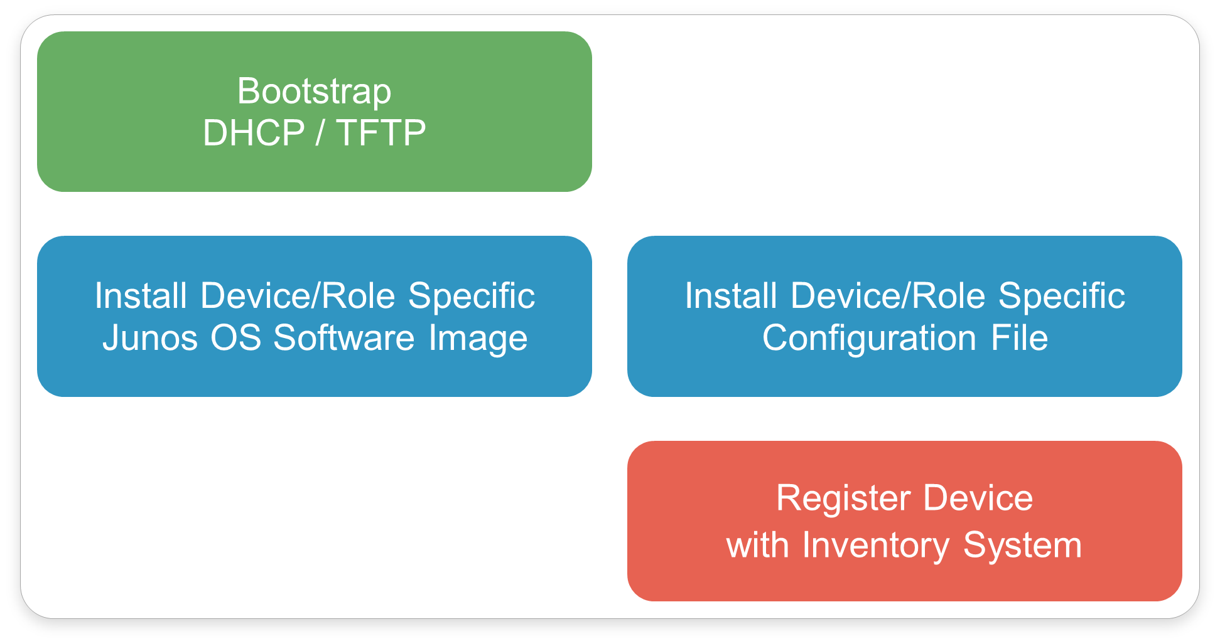
Make a Rapid Deployment Staging Center
So non-techie can stage gear on a bench

Slide 24
Now do it for a “Store”
Multiple devices, different roles
"Front-of-House"
Switch
EX2200
"Back-of-House"
Switch
EX2200
CorpVPN
Firewall Router
SRX240

Slide 25


Component Overview
Switch
EX2200
Switch
EX2200
Firewall Router
SRX240
Firewall Router
SRX240
Web Application

Slide 26
Staging Center Workflow

Slide 27
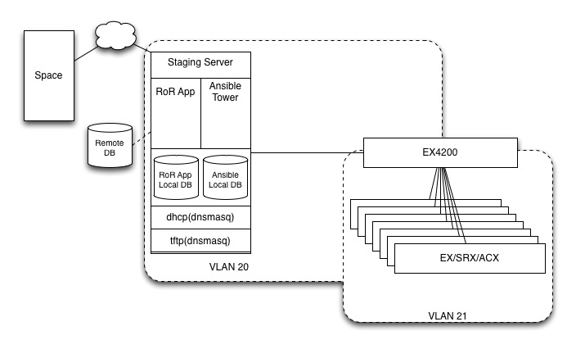
Overview

Slide 28

Staging Flow
Cable Device
Bootstrap
Provision
Register
Profit!

Slide 29
Cable Device
Each port of the EX4200 corresponds to a port in a “bench” in the deployment dashboard.
In this case it is Role specific…. Ge-0/0/0 is always an ex2200, ge-0/0/3 is always an srx100…. Etc
Device is cabled and plugged in… when device comes up, starts autoconf/ztp/bootstrap automatically

Slide 30
Bootstrap
Device Broadcasts for IP via DHCP….
Broadcast contained to VLAN 21… EX4200 is setup as a DHCP relay. EX4200 applies circuit-id (“port number:vlan name) to DHCP request… and forwards to Staging Server
Server determines what IP to issue based on circuit id….(same port always reachable on same ip)
Server sends back DHCP reply with IP and Pointers to a TFTP server (self), and Conf filename.

Slide 31


Bootstrap (Cont)
Request is intercepted, circuit ID is added
Switch Broadcasts Request for DHCP
Request is forwarded
Switch
EX4200
Using the circuit ID information, the server determines what port the switch is plugged into on the EX4200. Then issues a DHCP reply containing an IP, and pointers to tftp boot configurations
Server

Slide 32
Bootstrap (Cont)
Device retrieves configuration from TFTP server
Configuration sets up user credentials, enables Netconf, and LLDP, and sets up IP as static (prevent interface flapping).
Device is now ready to be provisioned.

Slide 33
Bootstrap (Cont)
Switch requests configuration file via tftp
tftp server responds with requested file
Switch
…
set user provisioner authentication password **** set system services Netconf ssh
…
Server
Switch is now bootstrapped and ready for Ansible to provision

Slide 34
Provision
Device is now sitting and waiting for provisioning.
User Can view device status, job status, and issue command to start provisioning from RoR app dashboard.
Dashboard is updated about device status via Netconf requests to the EX4200 about its LLDP neighbors.

Slide 35
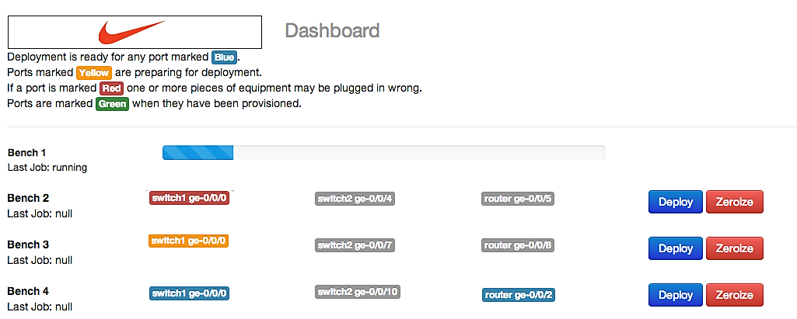
Deployment Dashboard

Slide 36
Provision
User now selects to start provisioning against specified devices… user provides Restaurant Type and code and submits form.
RoR app records the deployment in internal database, accesses remote database retreiving needed variables for configuration templates.
RoR app then issues request to Ansible Tower to setup the list of devices to run against, and variables gathered previously.

Slide 37
Provision (cont)
Ansible Tower Takes Over
Ansible Tower queues job, and starts running defined “playbook”. Each Task in Playbook is ran in parallel.
Playbook first checks for connection
Then creates log directory, and generates configuration file based on variables and templates.
Then Downgrades/Upgrades device if needed.
Then applies generated configuration

Slide 38


Deployment Workflow
1
Input Information into Application
Application Selects Configuration Template (World-Class / Type B vs. Type C)
Configuration Created with correct
Model
Host Name
Mac Address
IP Address
Junos O/S Version
Junos O/S Version updated (if needed)
Configuration Applied to Device
Device Rebooted to store Configuration
Device Ready for Shipping
Application
2
Store ID:
3
Switch
Type:
Database Store Info
Other:
Other:
Go!
4
5
Configure Device
6
7

Slide 39
One-Touch Provisioning
Server has two web applications that communicate:
Ansible tower and deployment manager
Switch
Ansible deploys to switch
Server
User requests a deploy in deployment manager. Deployment manager sets up and deploy and proxies to Ansible

Slide 40
Provision/Register
Finally, Playbook registers device in Junos Space
Device is Ready to Be Shipped/Installed

Slide 41


Slide 42
Deployment Workflow
1
Input Information into Application
Application Selects Configuration Template (World-Class / Type B vs. Type C)
Configuration Created with correct
Model
Host Name
Mac Address
IP Address
Junos O/S Version
Junos O/S Version updated (if needed)
Configuration Applied to Device
Device Rebooted to store Configuration
Device Ready for Shipping
Application
2
Store ID:
3
Switch
Type:
Database Store Info
Other:
Other:
Go!
4
5
Configure Device
6
7

Slide 43
Bootstrap Step – 1
Request is intercepted, circuit ID is added
Switch Broadcasts Request for DHCP
Request is forwarded
Switch
EX4200
Using the circuit ID information, the server determines what port the switch is plugged into on the EX4200. Then issues a DHCP reply containing an IP, and pointers to tftp boot configurations
Server

Slide 44
Bootstrap Step – 2
Switch requests configuration file via tftp
tftp server responds with requested file
Switch
…
set user provisioner authentication password **** set system services Netconf ssh
…
Server
Switch is now bootstrapped and ready for Ansible to provision

Slide 45
One-Touch Provisioning
Server has two web applications that communicate:
Ansible tower and deployment manager
Switch
Ansible deploys to switch
Server
User requests a deploy in deployment manager. Deployment manager sets up and deploy and proxies to Ansible

Slide 46

Sample Dashboard – Deployment In Progress

Slide 47
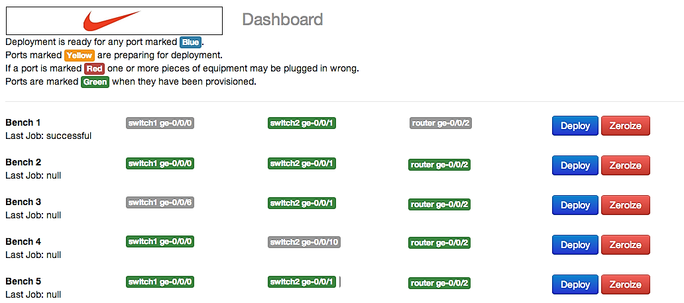
Sample Dashboard – Deployment Successful

Slide 48
Project Conclusion
Provided the Restaurant Builder Tool to automate and parallelize provisioning of Juniper devices
Delivery
Tool was delivered to in July 2014
Provided on-site and remote deployment support
Provided training and post-delivery support
Future
Tool can be easily generalized for other customers for rapid deployment of new devices
Tool can be optimized/cleaned-up further

Slide 49
Junos Space

Slide 50

Leverage Junos Space Externally
Junos Space and its various services provide a large amount of restful APIs
The APIs can abstract connection and authentication details
This enables the architect to leverage Junos Space in external scripts and programs
Generally, if it can be done via Junos Space directly, it can be done via the APIs

Slide 51
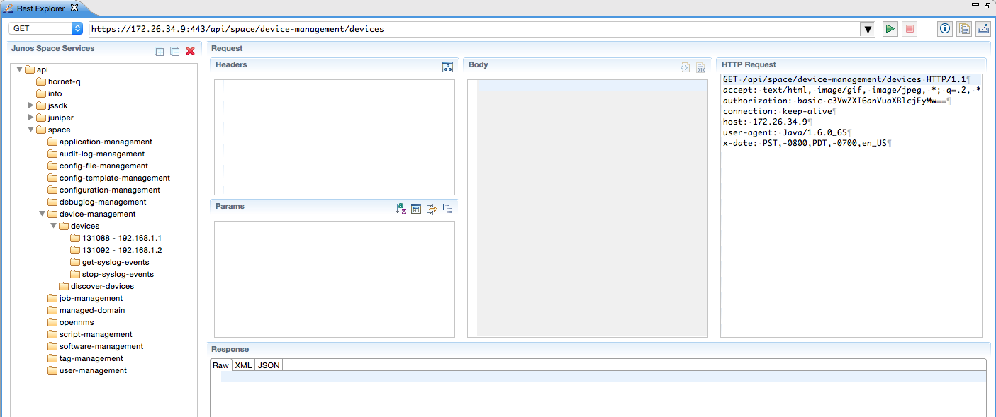
Junos Space API Explorer
Junos Space SDK plugin for eclipse contains “Rest explorer”
Can explore the APIs, figure out how to achieve the result, and what parameters are accepted

Slide 52
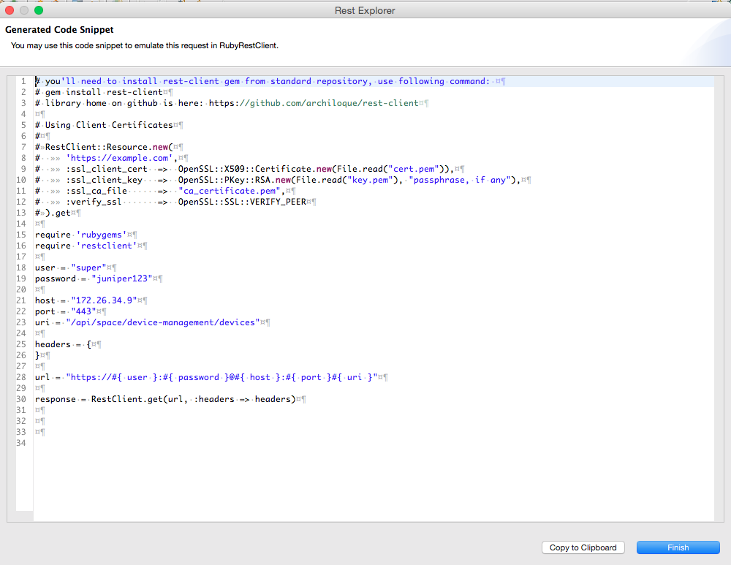
Junos Space API Code Generation
Junos Space SDK plugin for eclipse has code generation for popular languages
Implement and GO!
Found in Rest Explorer

Slide 53
Zero Touch Provisioning

Slide 54



Network Provisioning
Load image and configure
Time Consuming
Manual process requiring switches to be staged; takes days
Error Prone
80% of network downtime is due to manual configuration errors
Expensive
Staging is expensive and requires trained professionals
EX & QFX Series
Switches
Notes:
Provision of switches manually in mass deployment scenarios consume lot of time
There is need to automate this and ZTP to complete this task without operator intervention

Slide 55
Solution
Zero Touch Provisioning
Overcomes the problem of manual provisioning.
Expects DHCP and File Servers to provide sufficient data to provision
Notes:
55

Slide 56
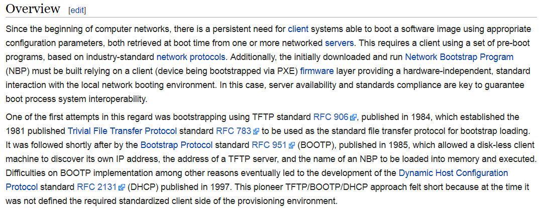
What is ZTP? (It’s Not Magic)
The Preboot eXecution Environment (PXE) is a standardized client-server environment to boot clients from a network. Only a PXE capable Network Interface Card and small set of protocols such as DHCP and TFTP are required.

Slide 57
Zero touch provisioning
Auto Image and Configure
Auto Image and Configure
Auto Image and Configure
EX & QFX
Series
Switches
Increase Speed of Deployment & Provisioning
Reduce Configuration Errors
Reduce OPEX

Slide 58
Topology
Switch
DHCP Server
File server
Notes:
58

Slide 59
Junos ZTP Topology – Components
DHCP Server:
IP
File Server:
Connected to Network
Power On
Zeroized / Factory Configuration
“request system zeroize”
Device:
Software Image Location
Configuration Location
Determines the
Serve the Requested Files
Notes:
I’ll give you a quick Junos ZTP overview to identify the key components in the solution. Basically there are two old Junos functions included here, called auto installation and auto configuration. To eliminate any manual intervention in terms of the software reload, as far as the initial configuration to be put in. We have a switch as a client. That switch is being added as a new switch coming with a factory default configuration. If you are concerned that it’s not the factory default configuration, you can always “zeroize” the configuration with the zeroize configuration command to back the configuration to the factory default state. Then you need to physically connect the switch to the network and you’re ready to power up. Before doing so, then we have to introduce the key components in the solution. It’s a DHCP server — basically that’s a central brain to guide the ZTP process and where the image and where the configuration is you should download on each of the switches. So that’s really the action determinator, so you have to make sure the client switch has a L2 or L3 IP connectivity to this DHCP server.
They also have other TFTP server or FTP server — that basically depends on the message or software you want to download onto the switch. You can run the switch, the DHCP, on the server — on one physical server — or you can run on different servers, so that’s totally up to the customers — the way how they feel — if they want to separate physical servers or not.

Slide 60
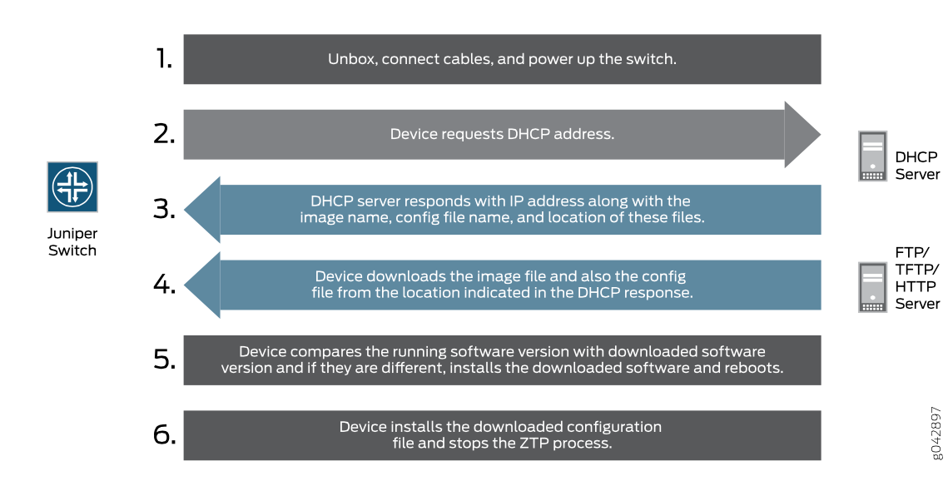
Basic ZTP Process

Slide 61
Junos Auto Installation (Simplified)
boot
Y
Normal
boot
Config?
N
DHCP
IP?
Y
Get DHCP
Options
N
Next
Server?
Y
TFTP
network.conf
Auto
Install
N
Any
TFTP?
Y
N

Slide 62
Device Implementation
ZTP Process runs as part of the JDHCPD daemon.
Is enabled when dhcp client and certain configuration is applied on device
Will read dhcp reply and trigger ZTP cycle based on DHCP Options
Notes:
62

Slide 63
Example Zeroized Config
vlans {
default {
vlan-id 1;
l3-interface irb.0;
}
}
chassis {
auto-image-upgrade;
}
system {
processes {
dhcp-service {
traceoptions {
file dhcp_logfile size 10m;
level all;
flag all;
}
}
}
}
interfaces {
irb {
unit 0 {
family inet {
dhcp {
vendor-id "Juniper-<model>";
}
}
}
}
vme {
unit 0 {
family inet {
dhcp {
vendor-id "Juniper-<model>";
}
}
}
}
}

Slide 64
ZTP DHCP Options
DHCP Option | Purpose / Description
66 or 150 | File Server Address, must be IP
43 sub option 00 | Software Image File Name / Path
43 sub option 01 | Configuration File Name / Path
43 sub option 02 | Symbolic Link vs Filename (Default Filename)
43 sub option 03 | Transfer Mode (TFTP / FTP / HTTP)
43 sub option 04 | Alternate Software Image File Name / Path
07 | Specify Syslog Server
12 | Specify Hostname of Client / Device
42 | Specify Ntp Server
Notes:
64

Slide 65
File Server
File Transfer Protocols supported: FTP, HTTP, TFTP
Although TFTP is supported, recommend that you use FTP or HTTP
these transport protocols are more reliable
Default protocol is: TFTP
Notes:
65

Slide 66
ISC DHCP Server Configuration
option space NEW_OP;
option NEW_OP.image-file-name code 0 = text;
option NEW_OP.config-file-name code 1 = text;
option NEW_OP-encapsulation code 43 = encapsulate NEW_OP;
group {
option tftp-server-name "17.176.31.71";
option log-servers 17.176.31.72;
option ntp-servers 17.176.31.73;
option NEW_OP.image-file-name "/images/jinstall-qfx.tgz";
option NEW_OP.transfer-mode "ftp";
host tme-qfx3500-1 {
hardware ethernet 88:e0:f3:71:a0:82;
fixed-address 17.176.31.19;
option host-name "tme-qfx3500-1";
option NEW_OP.config-file-name “/config/tme-qfx3500-1.config";
}
host tme-qfx3500-1 {
hardware ethernet f8:c0:01:c6:96:81;
fixed-address 17.176.31.20;
option host-name “tme-qfx3500-2";
option NEW_OP.config-file-name “/config/tme-qfx3500-2.config";
}
}
Vendor Specific options required for Auto image upgrade
Syslog and NTP servers
image that need to be installed. Supports symbolic link also
Configuration file for Auto configuration
MAC to IP Mapping and Host name for the system
Notes:
This gives you a template of the ZTP DHCP server configuration. From here, I also eliminate each function, to give you the sense of how the DHCP server guides each individual switch and how do the individual switches provision with the right image name as well as the configuration they should start with.
From this section you can check by yourself, I will not go through the configuration line by line. I want to give a high level quick points and examples, like say in the host name, we have TME-QFX-3500-1 — it’s identified by the hardware MAC address. And then from here it gives you the fixed address; then the option gives the host name — that’s the host name dedicated for this switch. Option wise, they give you new options and specify where the configuration is and the switch would be downloaded and what’s the configuration’s name. So from here, you can identify… so DHCP will guide for this dedicated switch, what’s a specific configuration you should download from where and what.
Of course, for the two switches, because if identical switch, I want all the switches loaded with the same software, so you don’t need to specify the different software names under the host structure. Rather, you put into the global option so that all the switches will load the equivalent software when they kick off the ZTP process.

Slide 67
DNSMASQ DHCP/TFTP Server Configuration
dhcp-leasefile=/var/lib/misc/dnsmasq.leases
log-facility=/var/lib/misc/dnsmasq.log
log-dhcp
port=0
enable-tftp
tftp-root=/tftpboot
dhcp-option=150,10.250.30.10
dhcp-vendorclass=set:ex2200-clients,Juniper-ex2200-24t # Set tags based on Vendor Class
dhcp-host=set:hostname,ma:ca:dd:re:ss # set tags based on mac
dhcp-option=tag:ex4200,encap:43,00,"image-file-name"
dhcp-option=tag:ex4200,encap:43,01,"config-file-name"
dhcp-option=tag:ex4200,encap:43,02,"image-file-type"
dhcp-option=tag:ex4200,encap:43,03,"transfer-mode"
dhcp-option=tag:ex4200,150,10.10.10.10 # file server
dhcp-range=tag:ex4200,10.10.10.2,10.10.10.100,255.255.255.0,1500m

Slide 68
Video
Zero Touch Provisioning / Junos OS for EX and QFX Series Switches

Slide 69
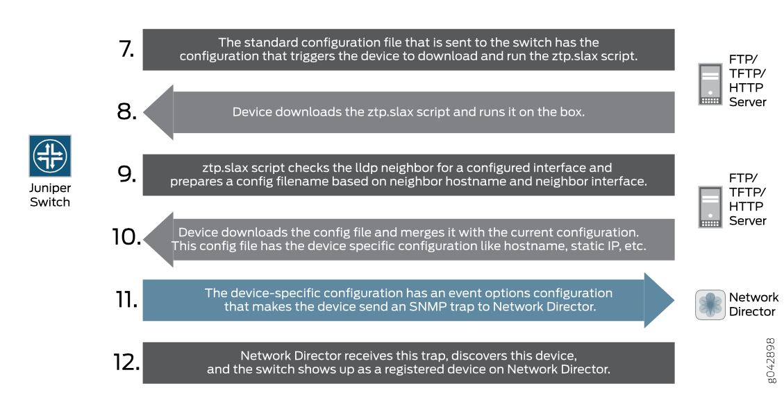
ZTP Process Extended

Slide 70
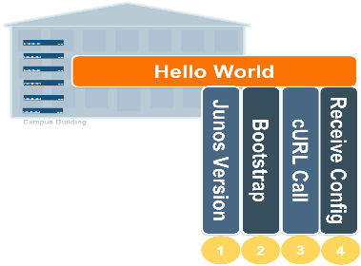



DHCP
TFTP
Advanced ZTP
Step 2
Step 4
Step 1
Step 3
Step 5
Junos Device
Junos Space
Notes:
Basic ZTP is where some other vendors leave off. But with the advanced automation capabilities of the Junos Operating system, we can take this many steps further and create custom solutions to fit most any need. This slide outlines a slightly more advanced process. Here you will note that steps 1 and 2 are identical. In truth step 2 is slightly different. Instead of passing a basic configuration that gives the device the ability to “phone home” back to Junos Space Network Director, the config contains a SLAX script that kicks off a cURL call that passes an attribute about the device to some type of server that is listening for this type of call.
This attribute can be any number of things on the device. Serial number, LLDP information of upstream ports, IP address of an interface and so on. Once this is passed to the listening server you can then use modern processes to create a config on the fly and pass it back to the device directly via netconf or use the Space APIs to integrate with Junos Space. There are many advanced options and too many to cover here. The main take-away here is that Junos Automation is highly-customizable.

Slide 71
Links
Example ztp.slax

Slide 72
SRX USB Boot
The SRX Series USB Auto install feature simplifies the upgrading of Junos OS images, when there is no console access to an SRX Series device that is located at a remote site. This feature allows you to upgrade the Junos OS image with the minimum configuration effort by just inserting a USB flash drive into the USB port of the SRX Series device and performing a few simple steps. This feature can also be used to reformat the boot device and recover the SRX Series device after boot media corruption.
Before you begin the installation, ensure that the following prerequisites are met: The Junos OS upgrade image and autoinstall.conf files must be copied to the USB device. The instructions on how to copy the image and create the file are provided below. Make sure that adequate space is available on the SRX Series device to install the software image.

Slide 73
Questions
What happens when no client goes to bound state?
What happens when no client has sufficient ZTP options?
What happens when file server failed to respond to ZTP request?
What happens when file downloaded is corrupted?
What happens when config file is errenous?
Device restarts dhcp client state on all configured interfaces
Notes:
73

Slide 74
Troubleshooting Commands
show dhcp client binding interface vme detail
show dhcp client statistics
request dhcp client renew interface <>
request dhcp client renew all
show dhcp client binding
show dhcp client binding brief
show dhcp client binding interface <>
clear dhcp binding all
clear dhcp binding interface <>

Slide 75
Further Troubleshooting
DHCP discovery / reply packets are reaching the server?
tcpdump –i <interface> udp
Check dhcp_log file on device
File Server Reachable?
netstat -rn
Ping
Notes:
75

Slide 76
Video
Use Junos Space Network Director – To Facilitate Zero Touch Provisioning

Slide 77
Build: Zero Touch Provisioning
Build
Configure
Collect
DHCP server
Option 7, 12 & 14
Minimal skill required by onsite deployment team
Ensure Consistent deployment in line with company policies
Reduce Data Center Build out from days to minutes
Network Engineers not tied up bootstrapping boxes
Enable creative solutions with SLAX scripts
No Vendor lock in
EX, QFX Switch
File server
FTP
HTTP
TFTP*

Slide 78
Bootstrapping with ZTP
ZTP can be leveraged to bootstrap an automation process
The device can load a configuration allowing access to Ansible/Puppet/Chef
Example…Defining a user and enabling
The device can register itself with Junos Space
The device can receive and on box script, directing it to take further action
Example, query a web server, sending the devices lldp neighbors…
The web server then takes the information and generates a custom configuration for that device

Slide 79

Compatibility
All EX, QFX, and Some SRX Series Devices
EX2200 v12.2R1 and above
EX2200-C v12.2R1 and above
EX3200 v12.2R1 and above
EX3300 v12.5R5 and above
EX4200 v12.2R1 and above
EX4500 v12.2R1 and above
EX4550 v12.2R1 and above
QFX3500 v12.3X50-D10 and above
QFX3600 v12.3X50-D10 and above
QFX5100 v13.2X51-D15 and above
Unofficially
Some SRX Series Devices
Junos Space – Network Director v13.1P5 and above

Slide 80
Server Provisioning Tools
Puppet – Chef – Ansible

Slide 81
Servers?
Server Provisioning? I thought we were working with Junos Devices?
The new DevOps is NetOps
Server Provisioning tools define states, not processes or scripts
Example:
Ensure package nginx is latest version
Generally defined in a domain specific language like ruby or yaml
Defining the state that the device should be in
Should have a route from a -> b…etc.
Faster implementation, lower failure rates, shortens times between fixes
Brings the networking environment closer to the concept of continuous delivery

Slide 82
DevOps for NetOps HISTORY
Evolution / Revolution
Server Virtualization and Cloud
History over +7 years
Open-Source Community
physical,
virtual, cloud
orchestration
infra.apps
built on IT
frameworks
(Hubot, Boxen)
puppet, chef
salt, ansible,
other IT frameworks
ad-hoc bash
Perl scripting
manually
configured
paradigm pivot-point!

Slide 83
Puppet
http://puppetlabs.com/
Compatible with:
EX 4300 v14.1X53-D10 and above
EX 4600 v13.2X51-D23 and above
QFX 5100 v 14.1X53-D10 and above

Slide 84
Puppet: IT Automation Software for Admins
What is Puppet?
Puppet is a configuration management system
It allows you to define the state of your IT infrastructure
Then automatically enforces the correct state
How Puppet helps?
Whether you're managing just a few servers or thousands of physical and virtual machines, Puppet automates tasks that admins often do manually, freeing up time and mental space so admins can work on the projects that deliver greater business value.

Slide 85
Puppet: IT Automation Software for Admins
How Puppet works
Puppet language is declarative (based on ruby), rather than procedural, meaning you tell Puppet what results you want, rather than how to get there
Its language is clear, simple and concise, easy for pretty much anyone to read and understand
This clarity facilitates easier collaboration between admins and colleagues on other teams, such as software developers, testers, and network administrators

Slide 86


Configure: Puppet
Build
Configure
Collect
Puppet Master
(server)
EX | QFX | MX
“netdev”
Puppet “netdev” module
"netdev" is a Puppet module stored on the Puppet master. The switch running the Puppet agent downloads this code via SSL.
Puppet Agent (client)
NETCONF “gem”
jpuppet package
Ruby Interpreter
Junos products are equipped with a NETCONF API that enables programmatic configuration changes and operational management via secure XML RPC
NETCONF
(FreeBSD)

Slide 87
Chef
https://www.getchef.com/chef/
Compatible with:
EX 4300 v14.1X53-D10 and above
EX 4600 v13.2X51-D25 and above
QFX 5100 v14.1X53-D10 and above

Slide 88
Chef: IT Automation for Speed and Awesomeness
What is Chef?
Chef turns infrastructure into code. With Chef, you can automate how you build, deploy, and manage your infrastructure. Your infrastructure becomes as version-able, testable, and repeatable as application code.
What are recipes?
Chef relies on reusable definitions known as recipes to automate infrastructure tasks. Examples of recipes are instructions for configuring web servers, databases and load balancers. Together, recipes describe what your infrastructure consists of and how each part of your infrastructure should be deployed, configured and managed.

Slide 89
Configure: Chef
Build
Configure
Collect
Chef Server
EX | QFX | MX
"netdev"
Chef “netdev” module
“netdev” module stored on the Chef Server. Chef Client downloads the module to the switch.
Chef Client
NETCONF “gem”
Jchef package
Ruby Interpreter
Junos products are equipped with a NETCONF API that enables programmatic configuration changes and operational management via secure XML RPC
NETCONF
(FreeBSD)

Slide 90
Ansible
http://www.ansible.com/
Compatible with:
All Junos Platforms

Slide 91
Ansible – Simple IT Orchestration
Ansible is a simple IT automation engine that automates provisioning, configuration management, application deployment, and intra-service orchestration
Designed for multi-tier deployments, Ansible models your IT infrastructure by describing how all of your systems inter-relate, rather than just managing one system at a time
It uses no agents and no additional custom security infrastructure
It uses a very simple language (YAML, in the form of Ansible Playbooks) that allow you to describe your automation jobs in a way that approaches plain English

Slide 92
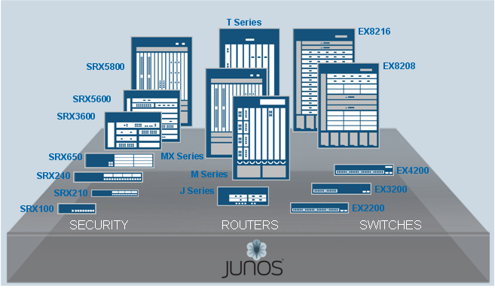
Build: Ansible
IT Automation Framework
Agentless and simple approach
Does not require coding skills
Work flow Engine
Ansible can be used for Network/Compute/Storage
Ansible
Transports
Python API
Plugins
Module
Library
Security
Routing
Switching
Playbook
Files
Junos_install_os
Junos_reboot
Telnet/Console
Junos_install_config
SSH
Junos_get_facts
Junos_shutdown
NETCONF

Slide 93
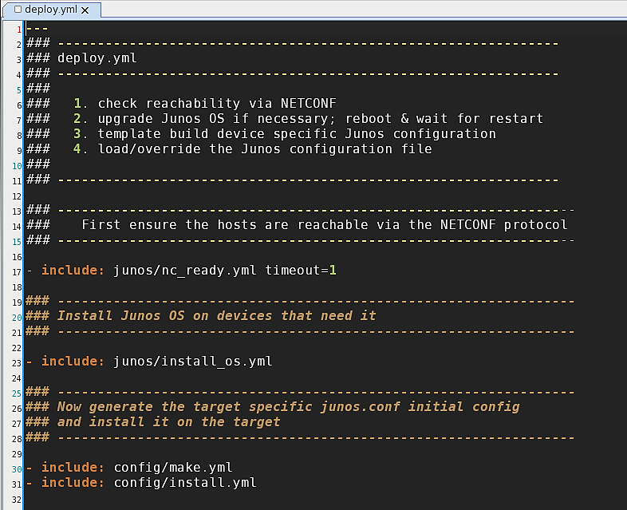
Deploy Playbook

Slide 94
Ansible-junos-stdlib
All Junos devices
junos_get_facts — Retrieve device-specific information from the host
junos_install_config — Modify the configuration of a device running Junos OS
junos_install_os — Install a Junos OS software package
junos_shutdown — Shut down or reboot a device running Junos OS
junos_zeroize — Remove all configuration information on the Routing Engines and reset all key values on a device
Juniper Networks provides support for using Ansible to deploy devices running the Junos operating system (Junos OS). The Juniper Networks Ansible library, which is hosted on the Ansible Galaxy website under the role junos, enables you to use Ansible to perform specific operational and configuration tasks on devices running Junos OS, including installing and upgrading Junos OS, deploying specific devices in the network, loading configuration changes, retrieving information, and resetting, rebooting, or shutting down managed devices.

Slide 95
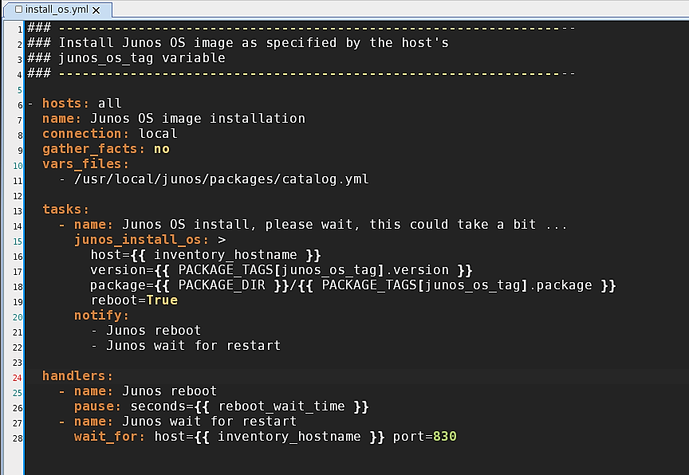
Playbook to Load Junos Software
idempotent
junos_install_os
performs installation
of Junos OS only if
the device does not
have it already installed
handlers only called
if OS is changed

Slide 96
Jinja2 Templates

Slide 97
What is Jinja2
Jinja2 is a widely used templating engine for Python.
Design and implementation is intuitive
Template inheritance
Allows you to build a base “skeleton” template that contains all the common elements of your site and defines blocks that child templates can override.
Easy to debug
Line numbers of exceptions directly point to the correct line in the template.
Execution is very fast
Widely adopted

Slide 98
Template basics
Variables are delimited by {{ … }}
Expressions (conditionals, loops, macros, blocks) by {% … %}
system {
host-name {{ host_name }};
name-server {
{% for dns_server in dns %}
{{ dns_server }};
{% endfor %}
}
}

Slide 99
If statements
Template:
user {{ user.name }} {
authentication {
{% if user.passwd %}
encrypted-password "{{ user.passwd }}";
{% elif user.key %}
ssh-rsa "{{ user.key }}";
{% endif %}
}
}

Slide 100
If statements – cont.
Rendered:
user bob {
authentication {
encrypted-password "$1$wDeov1";
}
}

Slide 101
For loops
Template:
{% for interface_name in core_interfaces %}
{{ interface_name }} {
output-traffic-control-profile CORE-MAP;
}
{% endfor %}

Slide 102
For loops – cont.
Rendered:
xe-4/1/0 {
output-traffic-control-profile CORE-MAP;
}
xe-4/2/0 {
output-traffic-control-profile CORE-MAP;
}
xe-4/3/0 {
output-traffic-control-profile CORE-MAP;
}

Slide 103
Filters
Filters use methods to manipulate data.
Template:
{% for interface_name in core_interfaces %}
{{ interface_name }} {
description “{{ desc|uppper }}”;
}
{% endfor %}

Slide 104
Filters – cont.
Rendered:
xe-4/1/0 {
description “UPSTREAM CON”;
}
xe-4/2/0 {
description “DOWNSTREAM CON”;
}
xe-4/3/0 {
description “MIRROR PORT”;
}

Slide 105
Include
Templates are able to directly include the content of files and other templates.
This allows you to split a configuration into multiple pieces.
Template:
system {
{% include “login.j2” %}
{% include “services.j2” %}
}

Slide 106
Include – cont.
Rendered:
system {
login {
user rick {
class super-user;
}
services {
ssh;
}
}

Slide 107
Yaml

Slide 108
What is yaml
YAML is a human readable mechanism for storing data that is easily mapped to common data types.
It supports hierarchical structures
Whitespace delimited (like Python) so files have consistent look.
Program language agnostic – supported by most.

Slide 109
Yaml - Example
---
ipsec_monitor_interval: 5
ipsec_monitor_threshold: 5
zones:
untrust:
name: untrust
interfaces:
- lo0.0
- ge-0/0/1.0
- ge-0/0/4.0
- ge-0/0/5.0
YAML files always start with 3 hyphens

Slide 110
Yaml – data types
YAML automatically detects data types. You can do programmy stuff with them, but we won’t be covering that.
---
boolean: true
float: 105.7
integer: 33
string: This is a string
string2: “This is also a string”

Slide 111
Yaml - lists
Lists can be in blocks using a hyphen+space to begin new items
---
- MX
- SRX
- QFX
Or inline delimited by comma+space and enclosed in square brackets
---
[MX, SRX, QFX]

Slide 112
Yaml – Dictionary/Associate Array
Associate Arrays can be in blocks with new lines and indention with keys and values separated by colon+space
---
name: lo0
logical_unit: 185
inet_address: 10.1.1.185/32
Or inline delimited by comma+space with keys and values separated by colon+space enclosed in curly brackets
---
{name: lo0, logical_unit: 185, inet_address: 10.1.1.185/32}

Slide 113
Yaml – Example Deconstructed
---
ipsec_monitor_interval: 5
ipsec_monitor_threshold: 5
zones:
untrust:
name: untrust
interfaces:
- lo0.0
- ge-0/0/1.0
- ge-0/0/4.0
- ge-0/0/5.0
Start of File
Associative Array
3 Top Level Keys
Nested Associative Array
Nested Associative Array
Nested List

Slide 114
Yaml - gotchas
Whitespace indented, but DOES NOT MIXED WHITESPACE!
Suggested format is to use (2) spaces for indents
Not hard requirement, but must be the same throughout a file
Comments begin with a number sign # and separated by whitespace

Slide 115
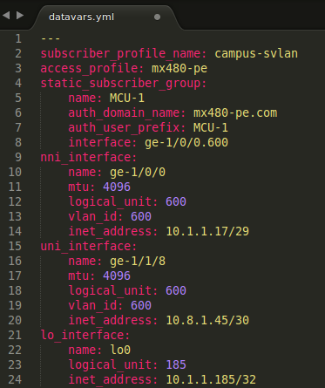
Yaml - editor
Using an editor with YAML support can make your life easier. Here is an example of Sublime 3

Slide 116
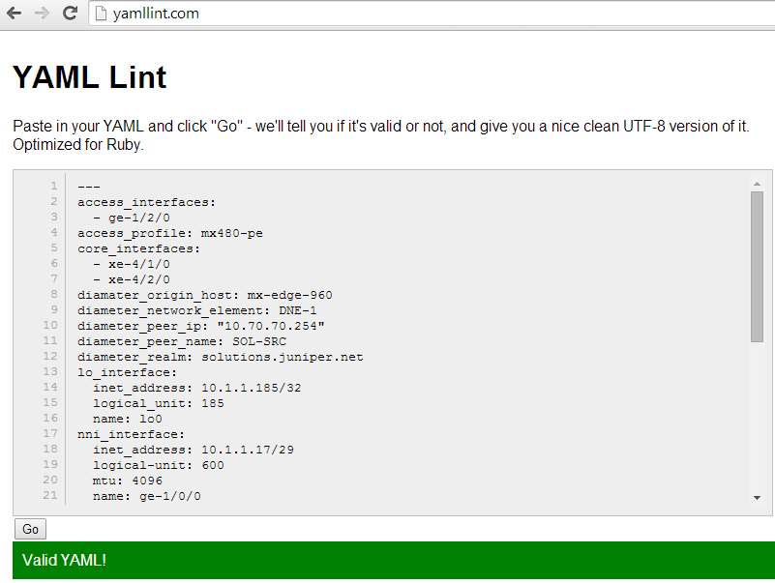
Yaml – Check validity (Linting)

Slide 117
NETCONF
Compatible with:
All Junos Platforms

Slide 118
NETCONF Explained
What is NETCONF?
XML Device API implemented over SSH subchannel
SSH –p 830 user@device –s netconf
Communicate using XML RPC
Configuration Commands & Operational Commands

Slide 119





Off-Box Workflow Automation
NETCONF – XML over SSH
Secure and connection oriented … SSHv2 as transport
Structured and transaction based … XML as RPC request / response
User-class privilege aware … Native to Junos
Management System
NETCONF XML PROTOCOL (RFC4741)
Security
Routing
Switching
Automate config changes, remote invocation of operational commands, collection of logs
Secure TCP/IP connections via SSHv2 (RFC4742)
NETCONF client libraries exist for a number of programming languages such as Java, Perl, Ruby, Python, and even SLAX !
XML

Slide 120
Junos Configuration
The following illustrates the Junos configuration as an XML document for a VLAN named “Accounting”
[edit]
admin@EX# show vlans Accounting | display xml
CLI
XML
[edit]
admin@EX-dc1# show vlans Accounting
description "Accounting Department";
vlan-id 500;
interface {
ge-0/0/12.0;
ge-0/0/13.0;
ae0.0;
}
<configuration>
<vlans>
<vlan>
<name>Accounting</name>
<description>Accounting Department</description>
<vlan-id>500</vlan-id>
<interface>
<name>ge-0/0/12.0</name>
</interface>
<interface>
<name>ge-0/0/13.0</name>
</interface>
<interface>
<name>ae0.0</name>
</interface>
</vlan>
</vlans>
</configuration>

Slide 121
Junos Operational Commands
The following illustrates the “show vlans” operational command in XML:
admin@EX> show vlans | display xml rpc
admin@EX> show vlans | display xml
XML RPC COMMAND
XML RESPONSE
<rpc>
<get-vlan-information>
</rpc>
<rpc-reply>
<vlan-information …>
<vlan-terse/>
<vlan>
<vlan-instance>0</vlan-instance>
<vlan-name>VLAN-blue</vlan-name>
<vlan-create-time>Wed Nov 16 12:42:03 2011
</vlan-create-time>
<vlan-status>Enabled</vlan-status>
<vlan-owner>static</vlan-owner>
<vlan-tag>500</vlan-tag>
<vlan-tag-string>500</vlan-tag-string>
<vlan-index>2</vlan-index>
<vlan-protocol-port>Port Mode</vlan-protocol-port>
<vlan-members-count>1</vlan-members-count>
<vlan-members-upcount>0</vlan-members-upcount>
<vlan-detail>
<vlan-member-list>
<vlan-member>
<vlan-member-interface>ge-0/0/19.0</vlan-member-interface>
</vlan-member>
</vlan-member-list>
</vlan-detail>
</vlan>
…
</rpc-reply>

Slide 122
Demo
Documentation: http://www.juniper.net/documentation/en_US/junos13.2/information-products/pathway-pages/netconf-guide/netconf.html

Slide 123
SLAX & JUISE

Slide 124
LIBSLAX
Junos OnBox scripting language
Based on XSLT
Exported SLAX from Junos
Standalone language
Open-Source (githib.com/juniper/libslax)
Imported back into JUNOS-12.2, 12.3
Re-imported on each release

Slide 125
SLAX Scripts
Operation Script
Event Script
Commit Configuration Script
Create Custom Commands
Diagnose Network Problems
Controlled Configuration Change
Automate Event Responses
Correlate Events
Assure compliance to business rules network/security policies

Slide 126
Event Automation
Image missing?
Event scripts are triggered by events on the device
Gather relevant troubleshooting info and correlate events from leading indicators
Automate event responses with a set of actions
event
Event Scripts
Actions
Benefits
Automate time-of-day configuration changes
Speed time-to-resolve to reduce the downtime
Automate response to leading indicators to minimize impact

Slide 127
Configuration Automation
COMMIT
CANDIDATE Configuration
ACTIVE Configuration
Benefits
Assure compliance to business rules and policies
Provide change management to avert and correct errors
Simplify and speed setup of complex configuration
Abstract complex configuration into a simple set of base commands
Enforce best practices and business rules
Actions
Commit Scripts

Slide 128
Configuration Automation
COMMIT
CANDIDATE Configuration
ACTIVE Configuration
Inspect and make changes to configuration
Issue a warning to the user
Issue an error and stop the commit operation
Expand user-defined macros into a full config
Actions
Commit Scripts

Slide 129
JUISE
JUNOS UI Scripting Environment
Open-Source (githib.com/juniper/juise)
The JUISE project allows scripts to be written, debugged, and executed outside the JUNOS environment
Tools for developers are available, including a debugger, a profiler, a call-flow tracing mechanism, and trace files
% juise @my-router my-script name1 val1 name2 val2

Slide 130
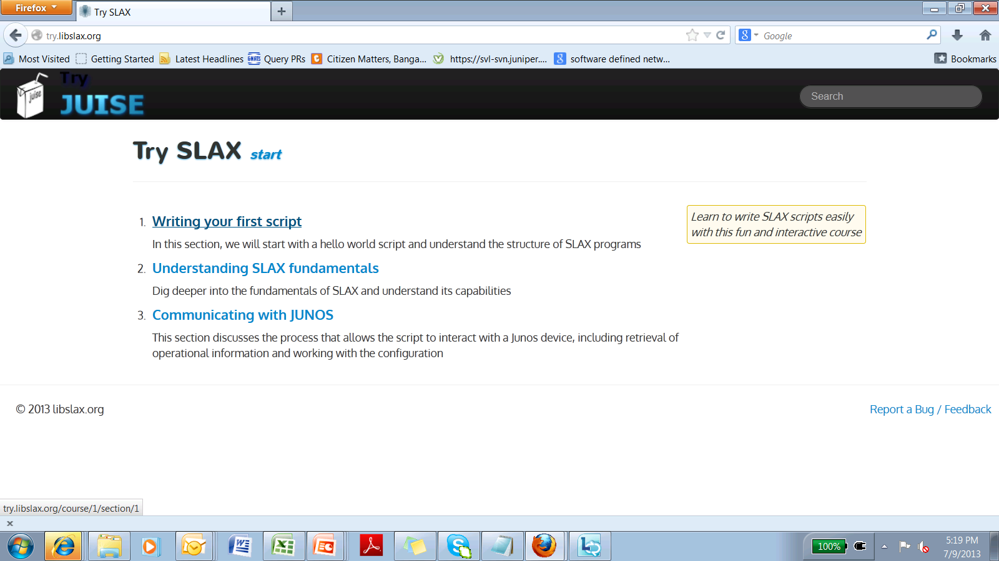
Try SLAX
http://try.libslax.org
Interactively learn and try SLAX programming language from web browser

Slide 131




Junos Workflow Automation
Bootstrap your automations with On-Box scripting, complete them with Off-Box
On the device:
Across the network:
“On-Box”
JUNOS
XML API
“Off-Box”
operations
commits
events
OSS integration &
Workflow automation
Net.Eng. Tools

Slide 132
Code Libraries

Slide 133
Programming Language Support
NETCONF
PERL
Java
Ruby
Python
SLAX
JUISE (JUNOS UI Scripting Environment)
EZ API
Python
Ruby

Slide 134
Programming Language Support
Perl
Available from Juniper Support Software download:
http://www.juniper.net/support/downloads/?p=netconf#sw
Ruby
Available from RubyGems.org, maintained by Juniper Networks
gem install netconf
Python
Available from open source project, not affiliated with Juniper Networks
https://github.com/vbajpai/ncclient
Java
Available from Juniper Support Software download:
http://www.juniper.net/support/downloads/?p=netconf#sw
SLAX
Available from Google code, maintained by Juniper Networks
http://github.com/Juniper/libslax/
http://github.com/Juniper/juise/
Also all found on
http://github.com/Juniper

Slide 135
Introducing "JUNOS PyEZ" Open and Extensible "micro-framework"
Remote device management and "fact" gathering
Troubleshooting, Audit and Reporting
Operational data
Configuration data
Configuration Management
Unstructured config snippets and templates
Structured abstractions
Generalized utilities for file-system, software-upgrade, secure file copy (scp), etc.
RPC Meta-Programming

Slide 136
Pyez – a layered approach
IT
Frameworks
Custom
Applications
Python Shell
Python script
interactive
simple → complex
Native Python data types (hash/list)
Junos specific not required
XML not required
junos-pyez
Junos specific
Abstraction Layer
micro-framework
open-source, Juniper
ncclient
NETCONF transport only
Vendor Agnostic
No abstractions
open-source, Community

Slide 137
Pyez – configuration changes
Unstructured
Structured
Junos config in text, set, or XML format
"snippets"
(no variables)
Resources
Structured abstractions defined by the junos-ez micro-framework
Juniper + Community
"snippets" that contain variables
Jinja2 is template engine
"templates"
(merge variables)
Junos
Configuration
write-only
read-write

Slide 138
Pyez – troubleshooting, audit, reporting
Easily retrieve data and extract as native Python
Conceptually like database tables and views that define the fields of data you want
Structured abstractions defined by the Junos PyEZ micro-framework
No coding required to create abstractions
Tables
Views
Juniper + Community
Junos
Configuration
Operational
Data
read-only

Slide 139
Pyez – “Hello world”
from jnpr.junos import Device
dev = Device(host='srx', user=‘eddie', passwd='password123')
dev.open() Device(srx)
dev.facts
{'domain': None, 'hostname': 'firefly', 'ifd_style': 'CLASSIC', 'version_info': junos.version_info(major=(12, 1), type=X, minor=(46, 'D', 15), build=3), '2RE': False, 'serialnumber': 'aaf5fe5f9b88', 'fqdn': 'firefly', 'virtual': True, 'switch_style': 'NONE', 'version': '12.1X46-D15.3', 'HOME': '/cf/var/home/rick', 'srx_cluster': False, 'model': 'FIREFLY-PERIMETER', 'RE0': {'status': 'Testing', 'last_reboot_reason': 'Router rebooted after a normal shutdown.', 'model': 'FIREFLY-PERIMETER RE', 'up_time': '8 minutes, 51 seconds'}, 'personality': 'SRX_BRANCH'}
dev.close()

Slide 140

Pyez – Connecting To devices
PyEZ supports connecting to Junos devices using standard user/pass, SSH keys, Agents and Forwarding.
"I am Vinz, Vinz Clortho, Keymaster of Gozer...Volguus Zildrohoar, Lord of the Seboullia. Are you the Gatekeeper?"

Slide 141
Pyez – Connect examples
Username and Password
dev = Device(host='srx', user=‘eddie', passwd='password123')
Connecting to a device via the SSH Agent or Actively loaded environment key
dev = Device('srx')
Connecting to a device via the default SSH key + Key password
dev = Device(host='srx', passwd='juniper')
Host, user, and passwd
No user, key, or password host keyword can also be omitted
Host and passwd only

Slide 142
Pyez – Connect examples cont.
Keyfile + password
dev = Device(host='srx', ssh_private_key_file='/keys/pkey',
passwd='juniper')
Keyfile w/out password
dev = Device(host='srx',
ssh_private_key_file='/keys/nopass‘)
Host, key file and password
Host and key file only

Slide 143
Pyez – disable facts
The automatic gathering of facts can be disabled. This is useful in situations where bugs or missing device types prevent facts from gathering.
dev = Device(host='srx', gather_facts=False)
dev.open()
Device(srx)
dev.facts
{}

Slide 144
Pyez – check connection (Probe)
To check if NETCONF can be reached the device can be probed. This is particularly useful in re-connecting after a reboot.
dev.probe()
False
dev.probe(timeout=30)
False
dev = Device(host='srx', auto_probe=5)
dev.open()
jnpr.junos.exception.ProbeError: ProbeError(srx)
Default timeout of 5 seconds
Specify timeout
Probe timeout before opening

Slide 145
Pyez – Config utilities
Included in the framework are various utilities. We will specifically cover some of the more common Configuration functions.
Load
Pdiff
Commit_check
Commit
Rollback

Slide 146
Pyez – load
Loads changes into the candidate configuration.
Changes can be in the form of strings (text, set, xml), XML objects, and files.
Files can be either static snippets of configuration or Jinja2 templates.
load() does NOT commit the change, it only loads it.
To commit changes use commit()
Set is not supported in JUNOS < 11.4

Slide 147
Pyez – config set
from jnpr.junos import Device
from jnpr.junos.utils.config import Config
dev = Device('srx')
dev.open()
set_commands = """
set system host-name myRouter
set system domain-name shermdog.com
"""
cu = Config(dev)
cu.load(set_commands, format='set')
<Element load-configuration-results at 0xb5f2048c>
Import Config util
Set commands in multi-line string
Create Config object
Load configuration onto device

Slide 148
Pyez – config from file
Configuration data can be loaded from a file on the local system.
The file extension can be used to determine the format, or it can be specified.
cu.load(path='config-example.conf')
cu.load(path='config-example.set')
cu.load(path='config-example.xml')
cu.load(path='config-example', format='text')
cu.load(path='config-example', format='set')
cu.load(path='config-example', format='xml')
Curly Text Style
Set Style
XML
Curly Text Style
Set Style
XML

Slide 149
Pyez – config from template
The framework can render templates and load them.
Variables can be stored in Python dictionary or loaded from a file.
tvars = dict(host_name=‘rick',
domain_name=‘shermdog.com')
cu.load(
template_path="config-example-template.conf",
template_vars=tvars)
Data for variables
Path to template and vars

Slide 150
Pyez – pdiff / diff
After a configuration has been loaded the diff (patch-format) between the current candidate and the provided rollback can be retrieved.
pdiff automatically calls print for debugging
cu.pdiff()
[edit system]
- host-name firefly;
+ host-name rick;
+ domain-name shermdog.com;
By default compare rollback 0

Slide 151
Pyez – pdiff / diff cont.
cu.pdiff(3)
[edit system]
- host-name firefly;
+ host-name rick;
+ domain-name shermdog.com;
+ time-zone America/Chicago;
The diff can also be stored into an object using diff()
diff = cu.diff()
A rollback id can be used to compare different rollbacks

Slide 152
Pyez – rollback
The candidate config can be rolled back to either the last active config or a specific rollback number.
cu.rollback()
True
cu.pdiff()
None
cu.rollback(1)
True
cu.pdiff()
[edit system]
- time-zone America/Chicago;
By default, roll back to last active - 0
This shows the config is rolled back
A rollback id can also be used

Slide 153
Pyez – commit_check & commit
Configuration changes can be checked prior to commit
cu.commit_check()
True
cu.commit ()
True
cu.commit(comment="Doc",
confirm=2)
True
If the commit-check results in warnings, they are not reported (at this time). A jnpr.junos.exception.CommitError is thrown
Comments and confirm timeout can be set

Slide 154
Demo
Documentation: http://www.juniper.net/documentation/en_US/junos13.2/information-products/pathway-pages/netconf-guide/netconf.html
http://github.com/Juniper

Slide 155
Migration Automation

Slide 156
Tier 1 ISP
Manual migration 26000+ services from existing M320 routers to new MX480/960 routers tedious, cumbersome and error-prone
Customers Problem
Customer wants to leverage existing Space (Network Management) Platform to perform migrations/configuration changes. A Space based application (Port Migration Tool) is developed to mitigate the problem
Interface with Space

Slide 157

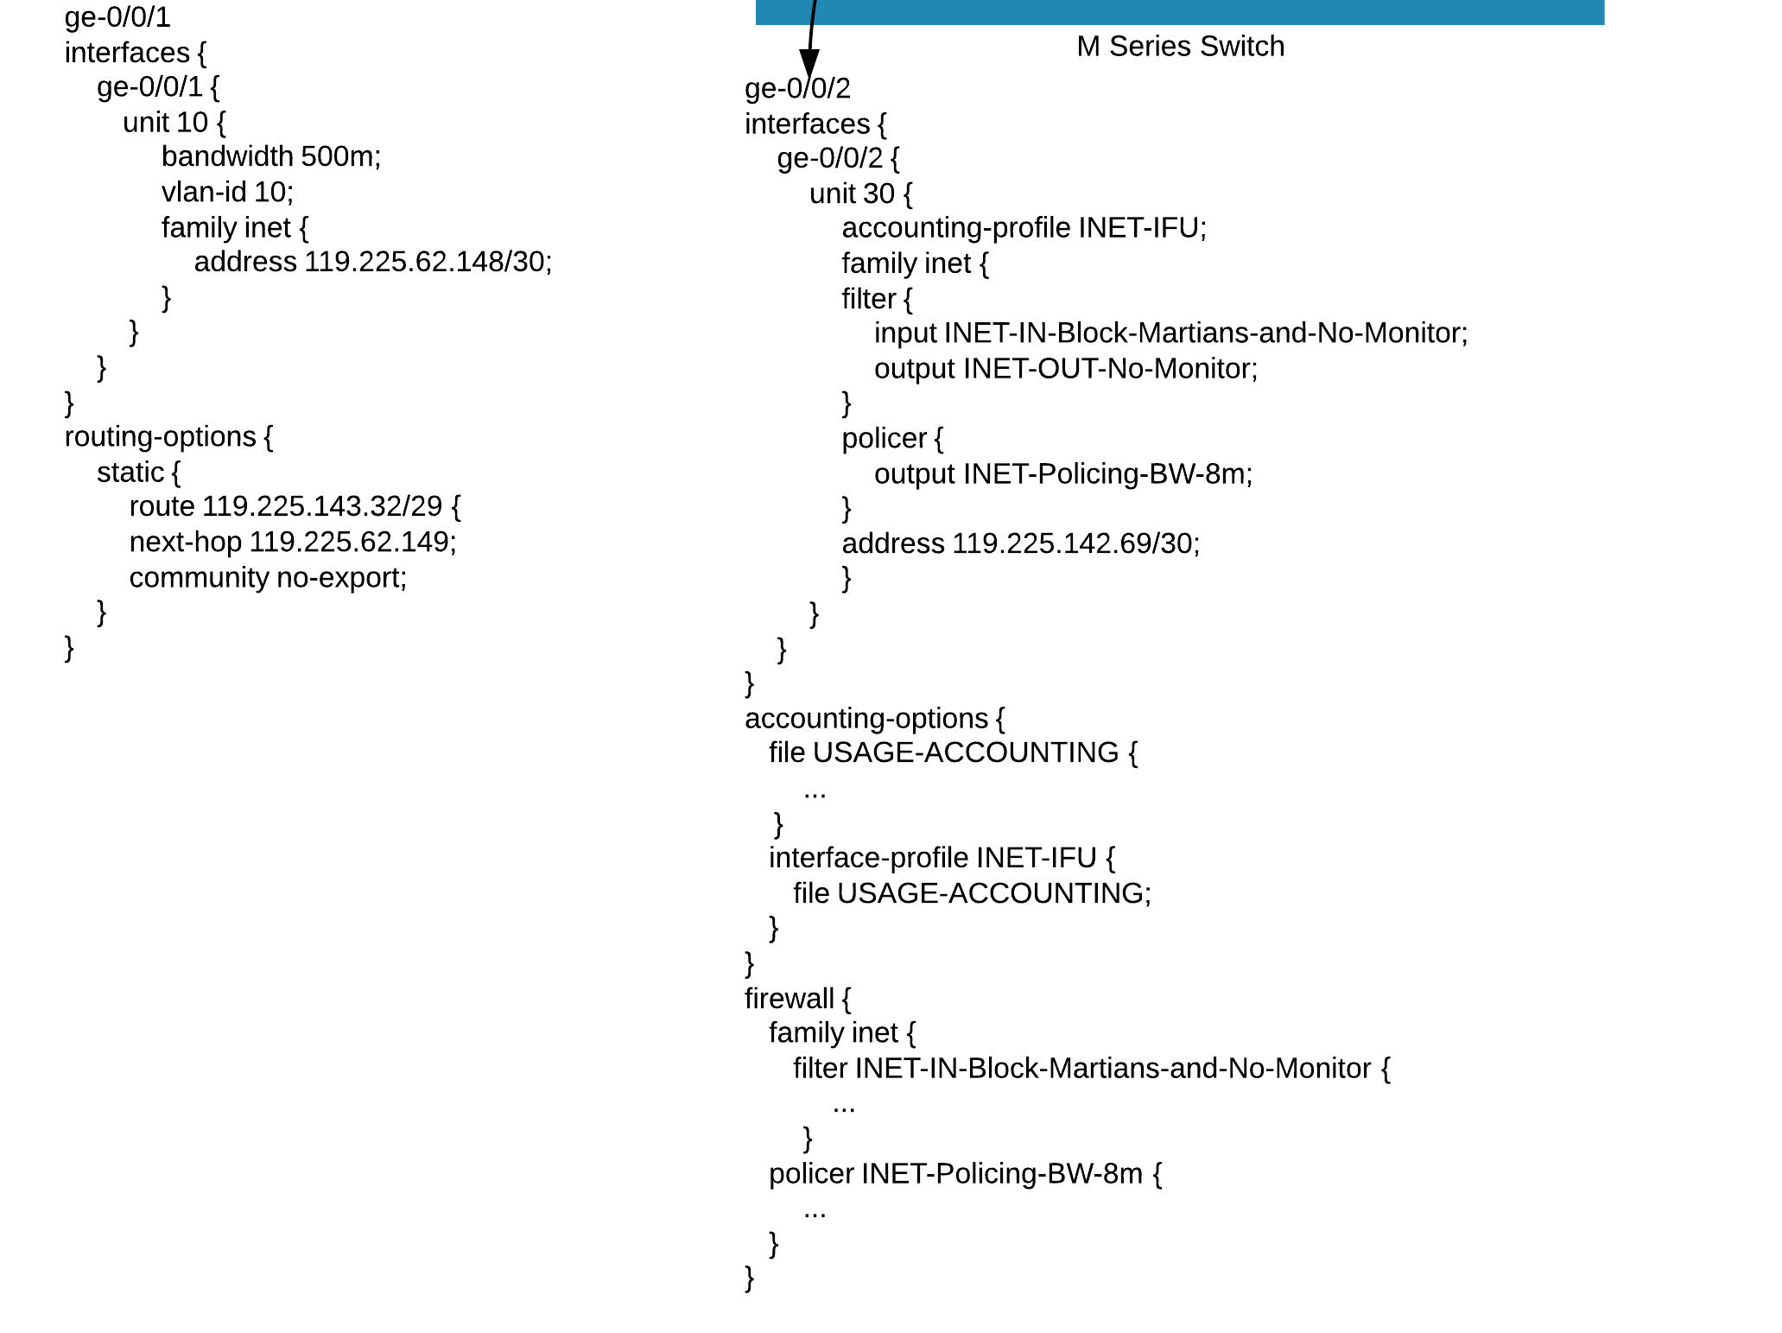
Customer Problem
What part of the configuration is needed to only migrate ge-0/0/2?
M Series Switch

Slide 158
Project Challenges
Design
Limited Core Routing expertise
Restricted access internal service provisioning toolset
Limited understanding of design approach
Lengthy design phase (almost 6-8 weeks)
Development
Weak Space SDK and API Documentation
Some Libraries (XML-CurlyBrace format conversion) not available in 13.1 SDK
Attempted to Port 13.2 Libraries (XML-CurlyBrace format conversion) to 13.1
Finally Juniper PS helped develop an custom external format conversion tool to solve the problem
Testing
Limited access to physical M320 and MX routers
Restricted access to internal service provisioning toolset
Lengthy testing phase due to the time zone difference and restricted production grade device access

Slide 159
High Level Port Migration Tool Design
Requirements:
Graphical User Interface
Deployed as a plug-in/app inside Junos Space
GUI to prompt for selection of single-port or multi-port migration
GUI to display two columns: one column for selection of source router/ports; target router/port(s)
GUI to have 1 click button to display the transformed configuration and SQL statements
GUI to have 1 click button to push the transformed configuration to target router
GUI to provide the ability to store and download the transformed config and SQL statements
Logs all transactions with date stamp
Generate report on each port migration with status of each service

Slide 160
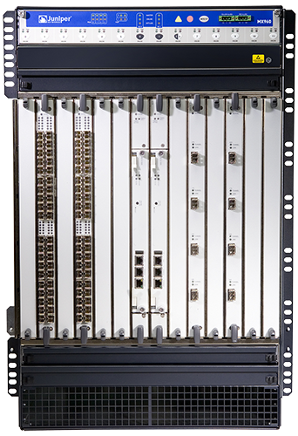
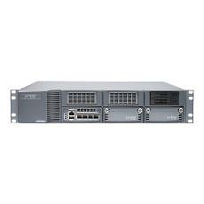
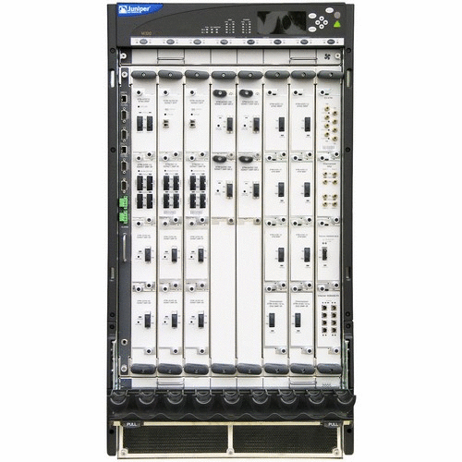
Port Migration Tool Deployment Architecture
Junos Space
MX960 Routers
UI Modules
Core Business Logic Modules
Logging, Tracking and Recording
JSA1500
Port Migration Tool
Network Director
Security Director
M320 Routers

Slide 161
Port Migration Tool Components
Deployed under existing Junos Space platform running on JSA1500 appliance
Can be launched from logging into the Junos Space platform
Requires the source M-Router and target M-Router to be managed by Junos Space platform
Components:
UI Modules: Enables/Guides the user to navigate, provide inputs to the tool and initiate actions
Core Business Logic Modules: Business logic to convert/transform/display M-Config to MX-Config. Based on service types
Non-Core Business Logic Modules: Logging, Tracking, Reporting functions

Slide 162
Port Migration Tool Details
The Migration Tool is developed utilizing:
Junos Space 13.1
Junos Space SDK
Eclipse with Junos Space Plug-in
VirtualBox
DMI Simulator with virtual MX and M (for initial development)
MX and M Routers with Junos 12.3 (for final and DVT)
Production M-router configurations used for validation testing

Slide 163
Development Environment
Development Environment
Space UI
RESTFul WS
Web Browser
Junos Space
JS SDK Components
JS SDK Plug-in
DMI Simulator
Ext Designer
Eclipse IDE
Virtual Box

Slide 164


Project Functional Flow
User Requests Migration of m1 ge-0/0/1 to mx1 ge/0/0/2
m1 configuration is parsed and a full configuration for the migration is created
Candidate Configuration for ge-0/0/1 includes all dependent configuration, ready to push to an empty router
User
Retrieves current configuration
Parsed against mx1 config
Retrieves current configuration
Space
MX1
netconf retrieves current configuration
Final Configuration for ge-0/0/1
M1
netconf retrieves current configuration
Includes only what is needed

Slide 165
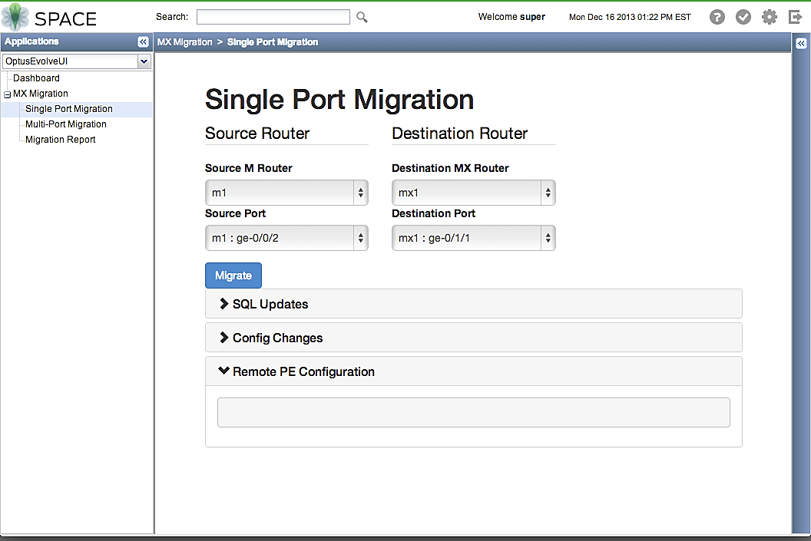
Port Migration Tool in Action

Slide 166
Project Conclusion
Provided Port Migration Tool to automate the migration of ports from M320 to MX routers
Delivery
Juniper is training and assisting with initial 3 migrations
Tool is in production and was successfully put into use to perform multiple production migrations
Future
New version of tool with Auto-push/rollback of configurations to support remote PEs
A project is underway to generalize the tool to fit other customers

Slide 167
Resources

Slide 168
Additional Resources
http://github.com/Juniper
http://developer.juniper.net
http://forums.juniper.net
http://pathfinder.juniper.net/feature-explorer/
https://learningportal.juniper.net

Slide 169
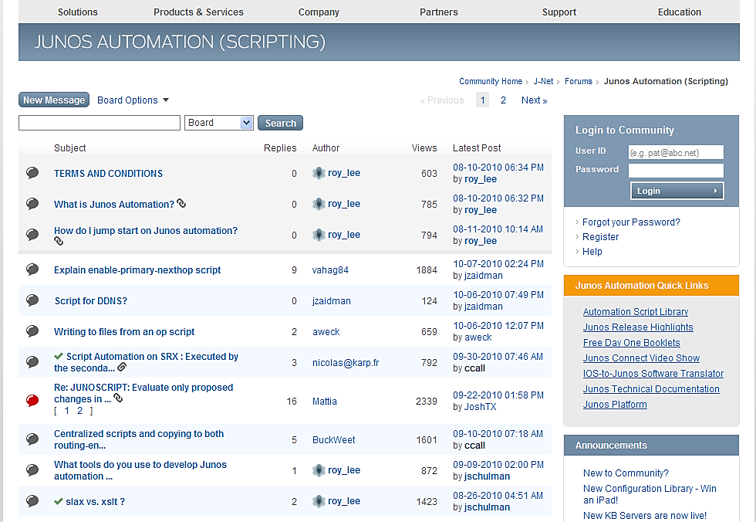
On-line Support Community
http://forums.juniper.net Select “Junos Automation (Scripting)”
The Juniper “J-Net” Forum is a message board resource monitored by Junos Automation experts.

Slide 170

Video Training
https://learningportal.juniper.net

Slide 171
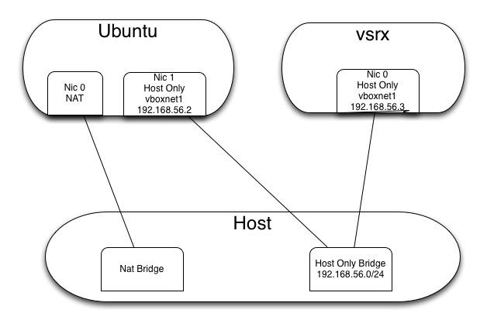
Automation Lab Setup

